Slide 1
Introduction to CT technique
DR / Hayam Abdelmonsif MD
Assistant Professor of Radiology , Medical Imaging and Interventional Radiology

Slide 2
CT imaging
Basic principles
CT scanner system
Concepts and Protocols
Post Processing

Slide 3
Basic Principles
Def: passage of x-ray beam with a predefined thickness (collimation) through the pt., that rotate around the center in the scanned level (image slice)
CT image/Scan/Cut
Adjacent small pixels (voxels) arranged inside a matrix made of rows and columns
Grey scale value corresponds to tissue density
Tissue density measured in HU.
Least value highest value
Air Ca/Bone/metal
Negative hundreds/thousands

Slide 4
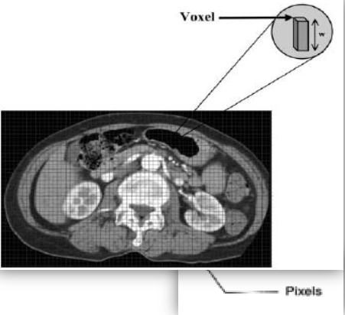
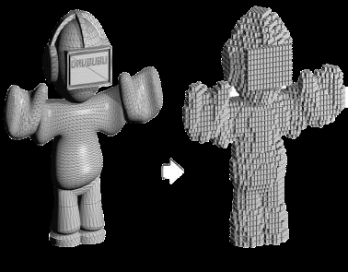
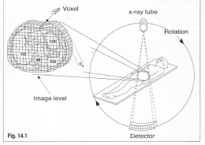
Increasing the number of pixels (matrix size) ….. Increase spatial resolution
Spatial resolution: the ability to see 2 adjacent points as seperate

Slide 5
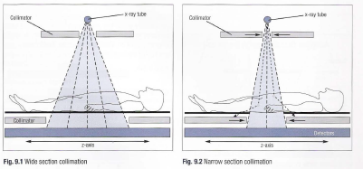
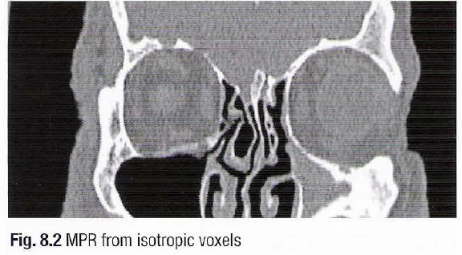
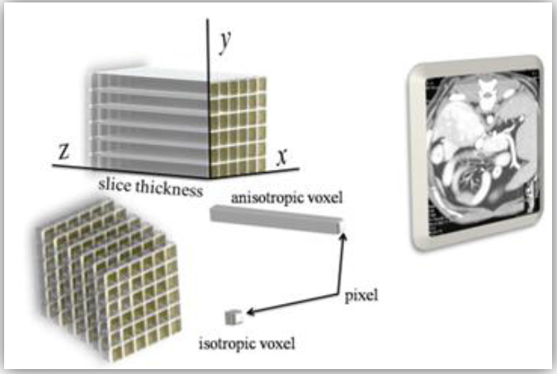
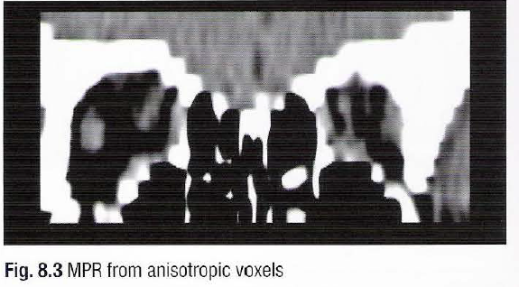
Thinner slices:
Better longitudinal resolution (longitudinal spatial resolution)
Better recostruction
But, higher exposure

Slide 6
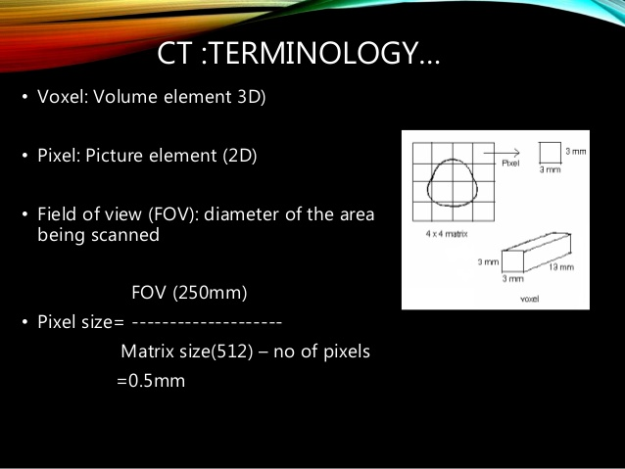

Slide 7
CT imaging
Basic principles
CT scanner system
Concepts and Protocols
Post Processing

Slide 8
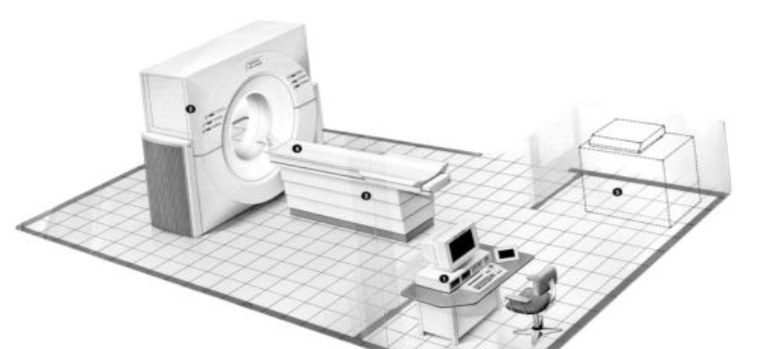
CT scanner system
Gantry: aperture through which the patient passes
It contains
X-ray tube: source of beam
Detector: Radiosensitive component that detect the x-ray emerging from the patient
Table: unit that moves in and out of the gantry upon which patient lies
Console: operator panel with main processing unit
Control patient exposure and scan parameters.
Workstation: separate computer unit. Power horse of processing

Slide 9
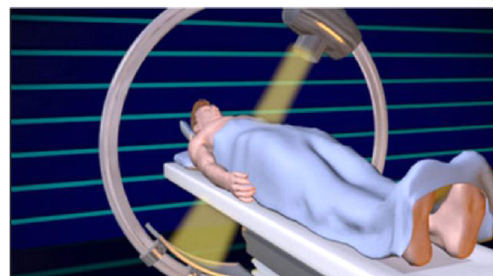
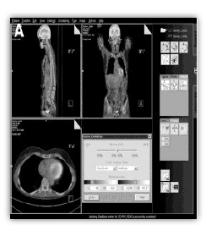
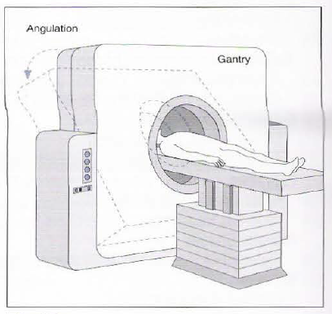
X-ray tube and detector array are coupled opposite to each other and rotate together
No gantry tilt in Multi-slice CT ….. Tilt through reconstruction
Gantry tilt: to obtain oblique images

Slide 10
CT imaging
Basic principles
CT scanner system
Concepts and Protocols
Post Processing

Slide 11
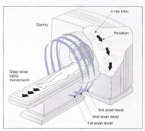
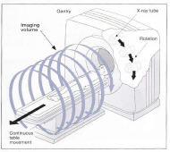
Axial Sequential imaging (non-helical) | Volumetric/spiral imaging (helical)
Complete single rotation … table moves pre-defined distance (slice interval) … next scan after a pause (tube delay) | Non-stop tube rotation with spontaneous table movement with speed relevant to rotation (pitch). “orange peel” ”volumetric scan”
Slow Doesn’t allow post imaging processing | Fast Image acquired as volume … processed
 | Low dose of CM + better conc ↑resolution, ↓ motion artifact Shorter scan time with longer exam coverage + no interval ( small lesions not missed)

Slide 12
Multi-detector CT (MDCT/MSCT)
Newer helical CT scanners
Detectors are arranged in rows perpendicular to the z-axis … acquire more than one slice/tube rotation.
So,
  ↑scan speed without compromising results.
  ↓slice thickness without prolonged scan time.(better processing)

Slide 13
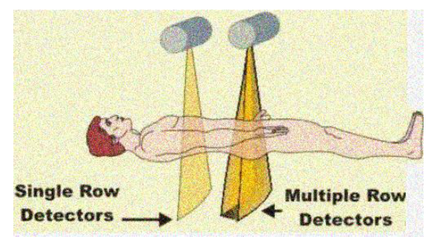
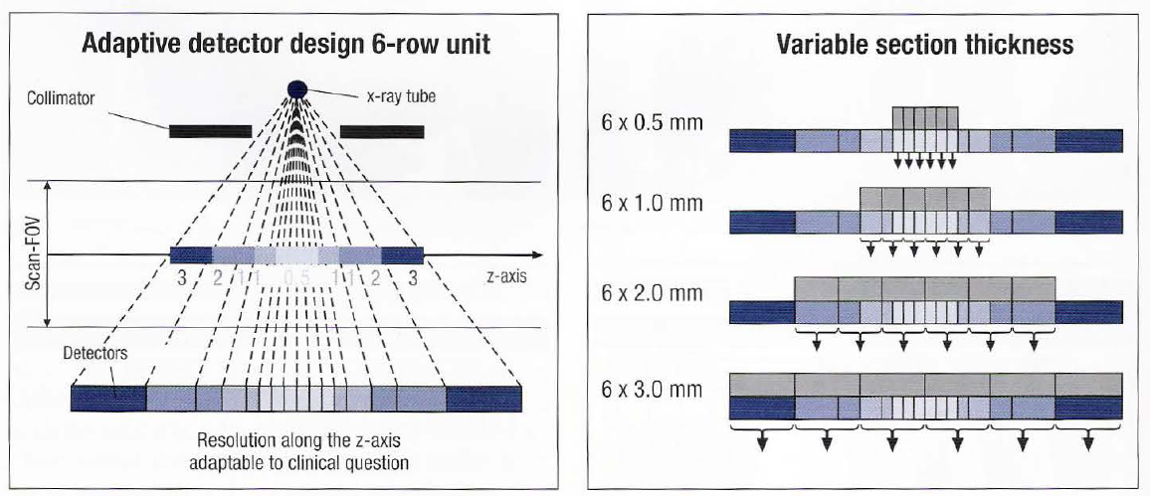
The detector rows are not inevitably equal in width. The adaptive array design consists of detectors that increase in width from the center to the edge of the detector ring and consequently allows various combinations of thickness and numbers of acquired sections.

Slide 14
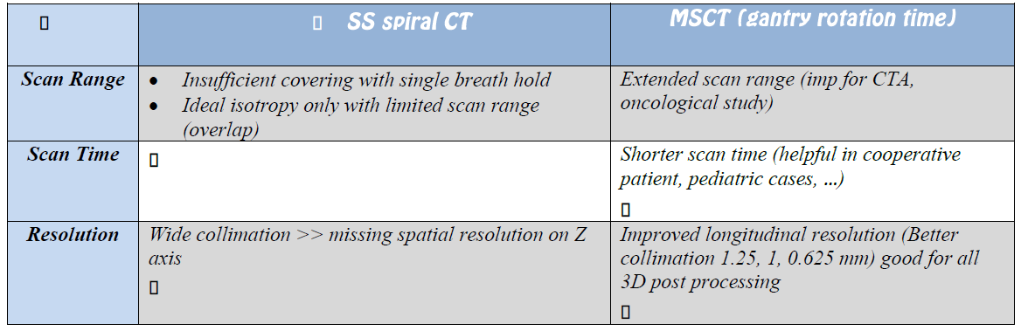

Long scan time
SS: colimation down to 1 mm ( 5, 8, 19 mm)
MS: collimation down to less than 1 mm ( sub mill metric = ultra high resolution)

Slide 15
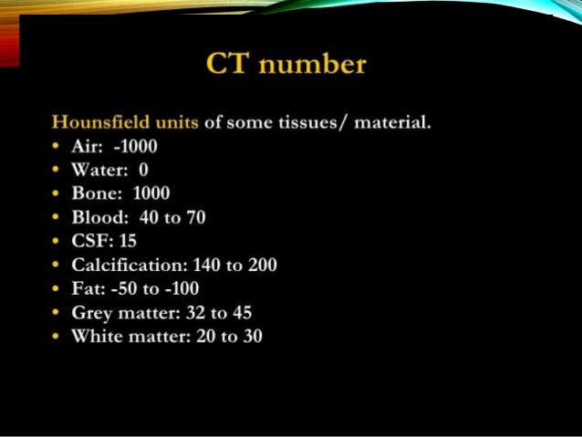

Slide 16
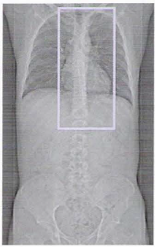
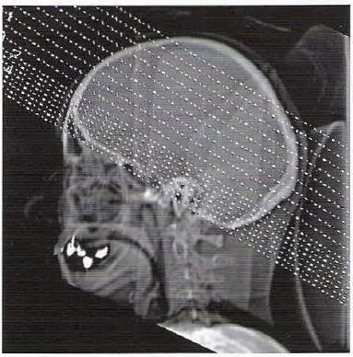
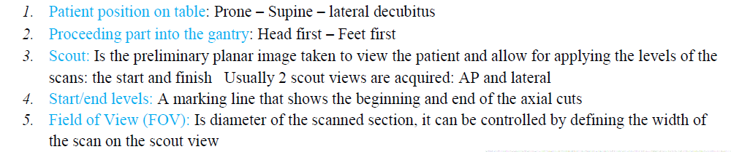
Image quality and scan parameters
Image quality depends on:
  Scanning parameters ( general, specific)
  Post processing technique
General scanning parameters:
6. Matrix Size: number of picture elements (pixels) present in the scanned cut
↑matrix size …. ↑resolution (512x512 better than 256x256)
↓FOV ( limited to the scanned organ) … ↑ resolution
7. Exposure values ( kvp 120-140, mAs 80-250) higher than planar imaging.

Slide 17
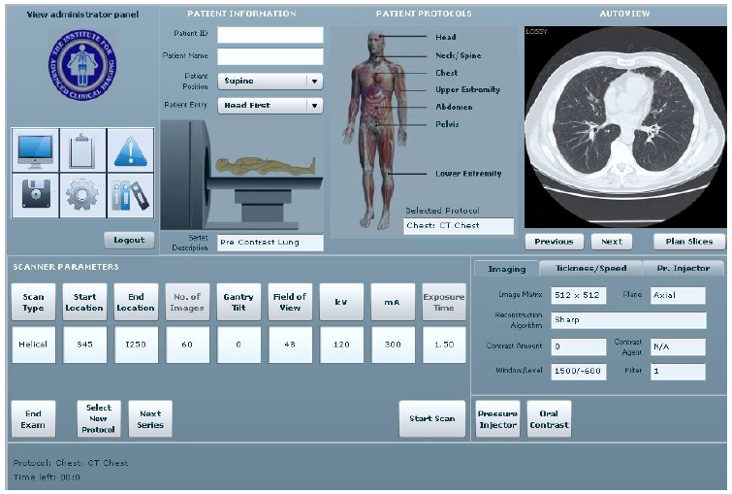

Slide 18
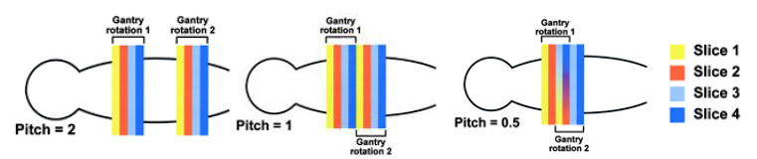
Specific Parameters for axial imaging:
1. slice thickness: width of x-ray beam “beam collimation”
2. Scan interval: distance of table movement before acquiring the next cut
Slice overlap occurs when thickness<interval
3. Tube delay: time pause between the sequential images.(required for tube cooling)

Slide 19
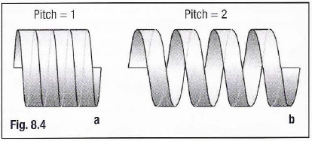
Specific Parameters for volumetric scan:
1. Beam collimation: final width of the beam
  In MSCT: beam collimation : total width
  Slice thickness: depend on the allowed detector row.
  Beam collimation 2 cm falling on a 4 dtector row, then each is 0.5 cm
  So, beam collimation = thickness of detector row x no of rows
2. Gantry rotation: time for single full rotation
3. Table increment: distance table travel per gantry rotation.
4. Pitch: table travel/rotation
collimation of beam
NB: pitch is usually set between 0.5-2 (If <1 … overlap, if >1… gap)

Slide 20
CT imaging
Basic principles
CT scanner system
Concepts and Protocols
Post Processing

Slide 21
Post Processing
Acquired scan data …. Gathered into single volume set … reconstructed.
1. MPR
2. CPR
3. MIP
4. MinIP
5. CT rendering
  SSR
  VR

Slide 22
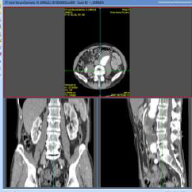
MPR(multi-planar reformat)
Generate image in one of 3 principle planes OR oblique planes of preference

Slide 23
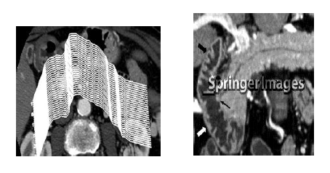
CPR(curved planar reformat)
Variant of MPR.
Reconstruction of image by means of a freely drawn plane eg. Ureter viewing its course.

Slide 24
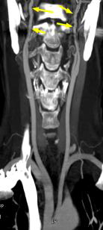
Intensity projections
MIP(maximum intensity projection) | MinIP(minimum intensity projection)
All voxels with CT density above a preset threshold are shown. | All voxels with CT density below a preset threshold are shown
So, Bones and high density contrast appear | Remove bone
Image contrast containing cavities | Image air containing structures
Angiography | Bronchography, Tracheography

Slide 25
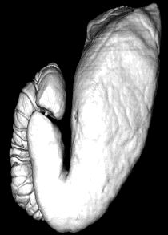
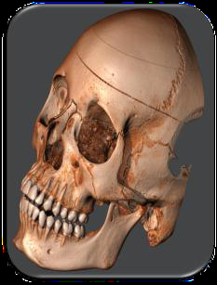
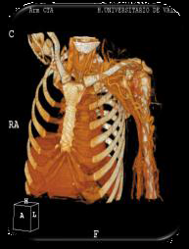
CT rendering techniques
Surface Rendering | Volume Rendering
Acquire data volume above a predefined threshold → transform into a 3D grey scale image → apply lighting | Acquire all data → make a 3D image with each density having a color and transparency → apply lighting effects

Slide 26
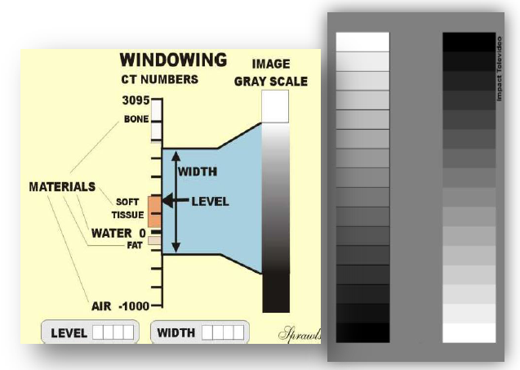
Window width and Window level(WW/WL)

Slide 27
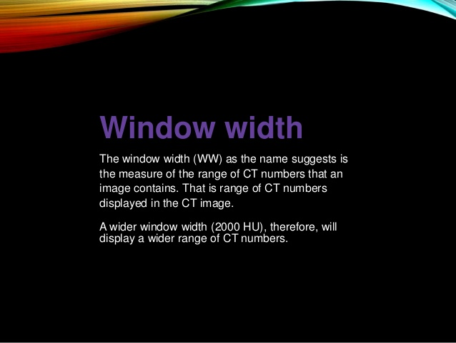

Slide 28
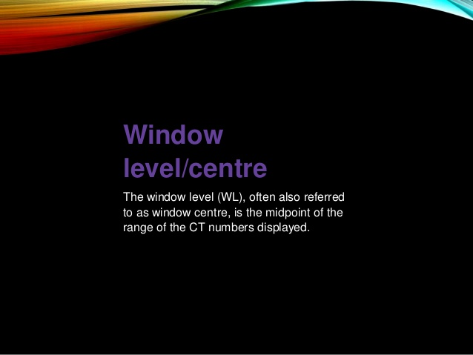

Slide 29
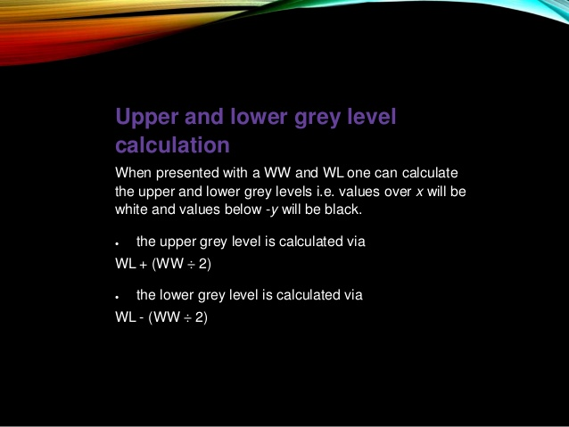

Slide 30
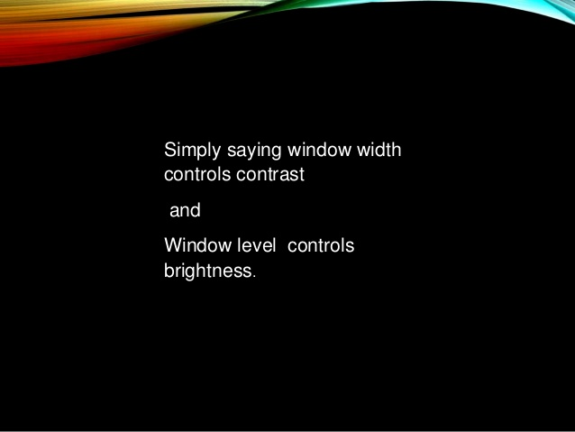

Slide 31
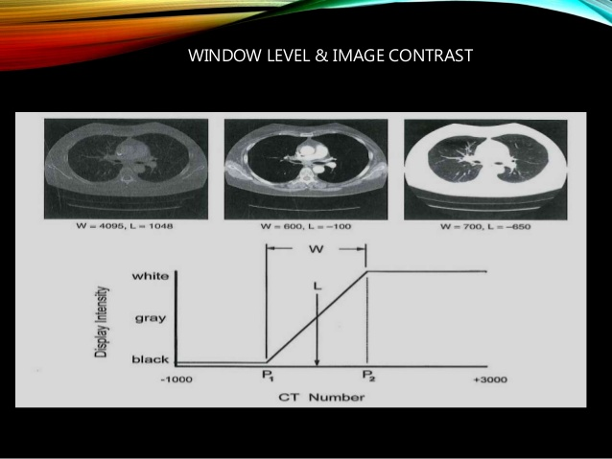

Slide 32
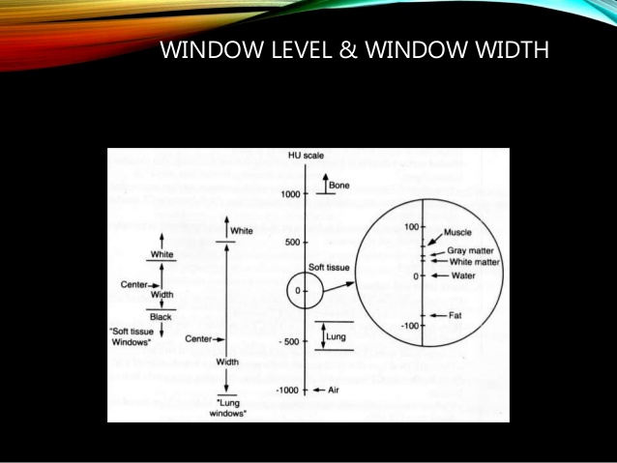

Slide 33
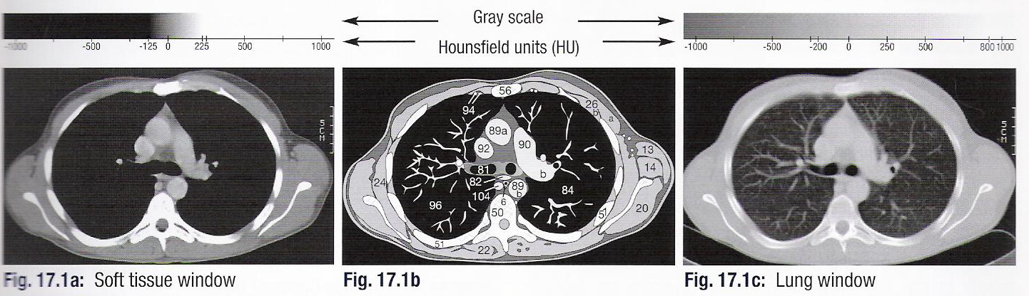
Adjusting Window width and window level
Soft tissue window 350/50 (-125 HU … +225 HU)
Lung window 2000/-200 (-1200 HU … 800 HU)
اللى اقل منة ... اسود, اللى اكثر ... ابيض
Brain Window 80/40
Bone window 1500/350

Slide 34

General scheme
Applied for any technique, any modality of imaging with some modification as will be mentioned
1- Definition and methods
ما قبل الفحص
ما بعد الفحص
2- Ind هتعمله ليه؟؟
7- After care
ما تخبر به المريض و المسئول عنه؟؟
الفحص
3- # امتى متعملوش؟؟
8- Complications
4- Patient prep تحضير المريض
5- CM الصبغة المستخدمة
6- Technique(Preliminary film, films, modifications or post processing)
9. Normal Findings

Slide 35
General scheme
1. Definition and methods
2. Indications
Vascular, inflamatory, trauma, autoimmune, metabollic, Iatrogenic-Idiopathic, Neoplastic, Acquired, Congenital, Degenerative, Endocrine
3. Contraindications (relative or absolute)
    Due to radiation
    Due to contrast medium: (non-fasting, allergy, renal impairment)
    Due to technique: irritable pt, sepsis at site of injection, not diagnostic ( relative #) as emergency, Renal colic.
Notes:
Due to radiation:
*radiation effects are either hereditary, somatic (stochastic – all or none e.g. Cancer, deterministic e.g. cataract) so
*principles guiding any diagnostic radiation: justification, ALARP
*justification is imp for women in reproductive age: 10 day role (def, why, exceptions: sex denial, menses, OCPs or IUD for at least 3 ms, sterilized) , arguments (organogenisis 4th to 8th wk, irradiation of unfertilized ova, benefit from exam versus hazard) 4 weeks role.
* preg or not, wait to be sure or safe way as US, if necessary dec dose without dec diag value, protect abd and pelvis

Slide 36
General scheme
4. Contrast medium
5. Equipment
    Radiography table and overcouch tube
    Emergency drugs and resuscitation equipment
5’. Patient preparation
  Hospital admission?!
  Women in Child BP
  Explain and consent, from 16 yrs up or their parents
  Bowel preparation
  Previous films and notes
  If risk of bleeding … coagulation profile
  Premedication …(non cooperative pt with painful procedure).
  If CM to be used: Fasting (4hs … children, 6 hrs … adult), S.creat

Slide 37
General scheme
6. Technique
Preliminary film (name, reg num, date, side marker)
  -Exposure factors
  -Preparation.
  Opacities.
  Radiological signs.
Films
Additional techniques or modifications

Slide 38
General scheme
7. After care
  Instructions to the patient and the ward.
  Observe for CM reaction
  Renal dialysis if urgent contrast in renaly impaired patient.
8. Complications
  Due to anaesthetic
    General or local
  Due to the contrast medium
  Due to the technique
    Local or distant (generalized).
Notes:
Anaeshthesia:
general
local (allergic, toxic) max dose of lignocaine is 200 mg (0.3 mg/kg)
toxic S/O: paraesthesia, twitching, convulsions, arrhythmia, resp dep, arrest

Slide 39
Details
Anaeshthesia:
General
Local (allergic, toxic)
Max dose of lignocaine is 200 mg (0.3 mg/kg)
Toxic S/E: paraesthesia, twitching, convulsions, arrhythmia, resp dep, arrest
Sedation of children
Chloral hydrate
  Dose: 50-70 mg/kg (1g in 5 mL syrup) roughly half the weight. Repeat if not asleep in 30 min. Max dose is 2 gm.
  S/E and # :
    Vomiting (mucosal irritant, vomit within 15 min repeat)
    URTI (worsen catarrhal)
    Liver disease (route of met: alcohol deh, full act in 5 yrs)
    Neurological and renal impairement.

Slide 40
Contraindications due to radiation
Radiation effects are either hereditary, somatic (– all or none e.g. Cancer, deterministic e.g. cataract) so
Principles guiding any diagnostic radiation: justification, Justification is imp for women in reproductive age: 10 day role (def, why, exceptions: sex denial, menses, OCPs or IUD for at least 3 ms, sterilized) , arguments (organogenisis 4th to 8th wk, irradiation of unfertilized ova, benefit from exam versus hazard) 4 weeks role.
Preg or not? 1. wait to be sure OR 2. safe way as US, if necessary 1. decrease dose without decrease diagnostic value, 2. protect abdomen and pelvis

Slide 41
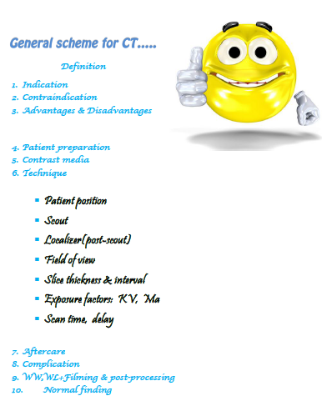

Slide 42
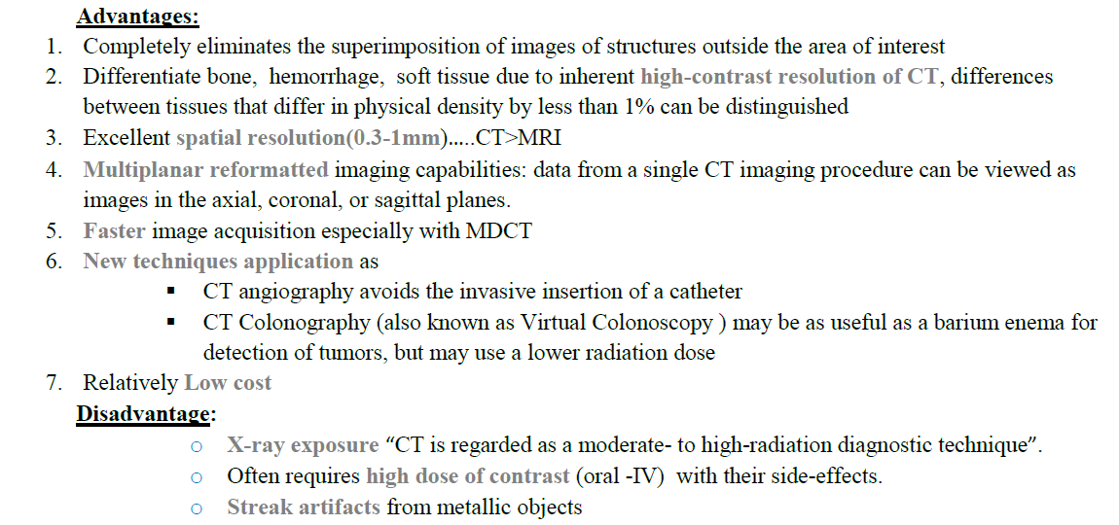

Slide 43


